Slide 1
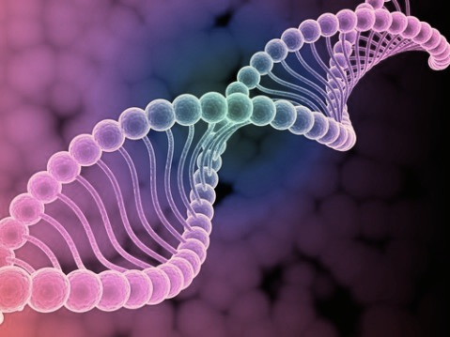
Basic Introduction
to Molecular Biology

Slide 2
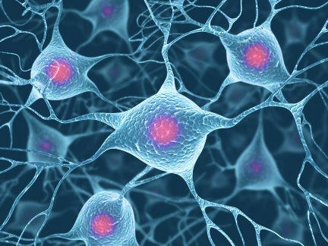
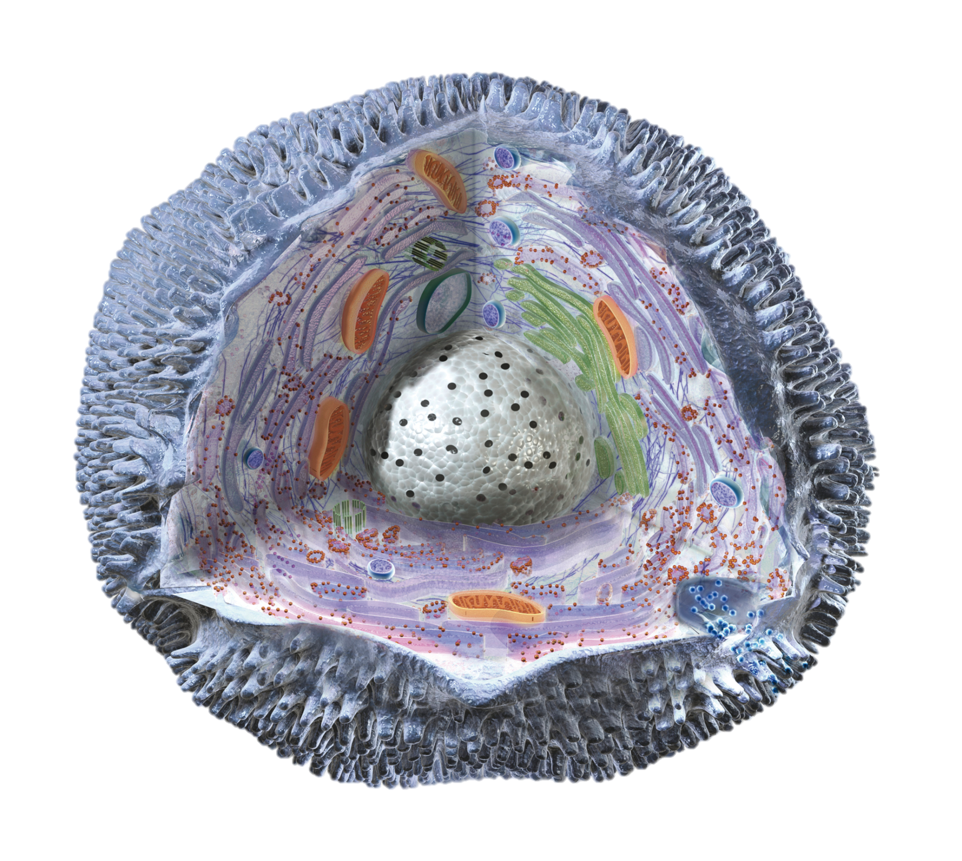
Cells
Notes:
Smallest structure and functional unit of an organism
prokaryotic cells: Bacteria (E.coli)
Eukaryotic: Has a nucleolus. Have evolved to partition different functions to different locations in the cell : plants animals … likely evolved from procraryotic cells

Slide 3
How many cells are in a human body?
Notes:
37 trillion
Tricky to compute. Use volume? Use mass? 15 trillion vs 70 trillion

Slide 4
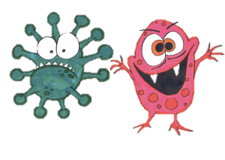
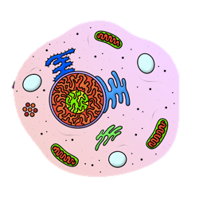
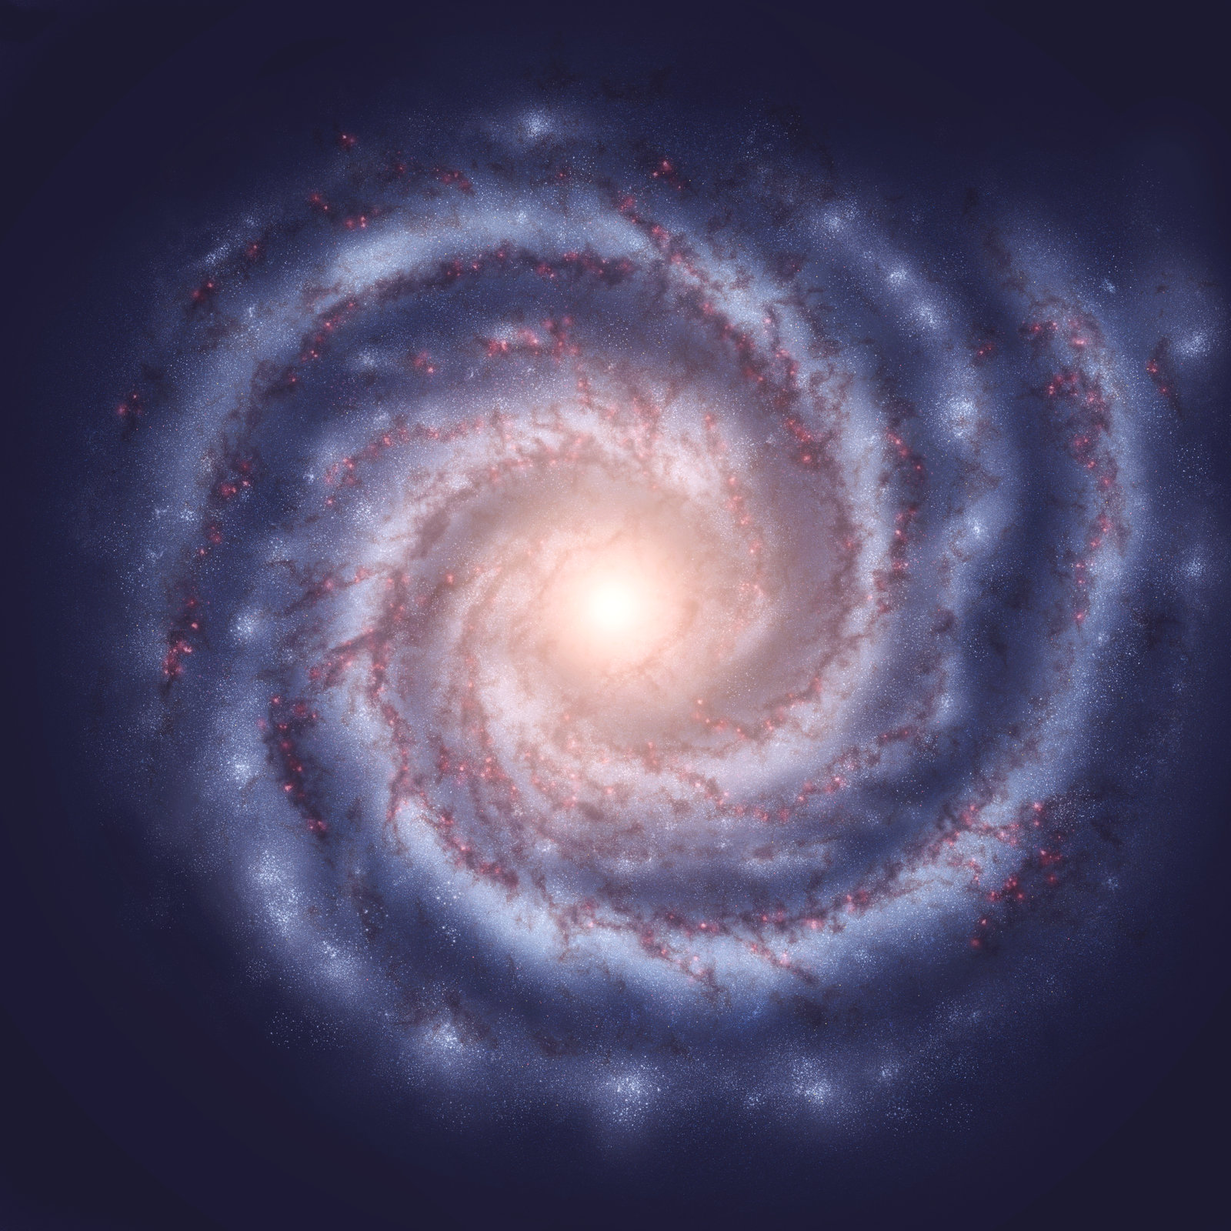
Number of cells in a human body
10¹⁴
bacterial cells!
10¹³
(10 trillion)
10¹¹
(400 billion)

Slide 5

Cells divide. How often?
10¹⁶
10,000,000,000,000,000 / lifetime
10¹¹
100,000,000,000 / day

Slide 6
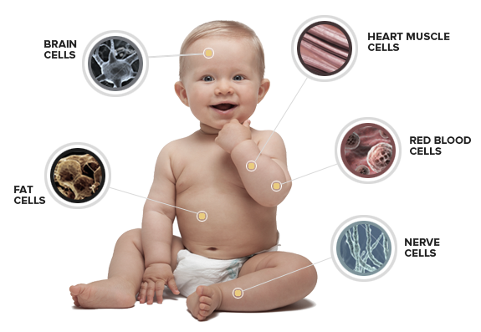
There are many different kinds of cells in our body

Slide 7

How do the cells know what to do? And why are some cells different from others? [VIDEO]

Slide 8
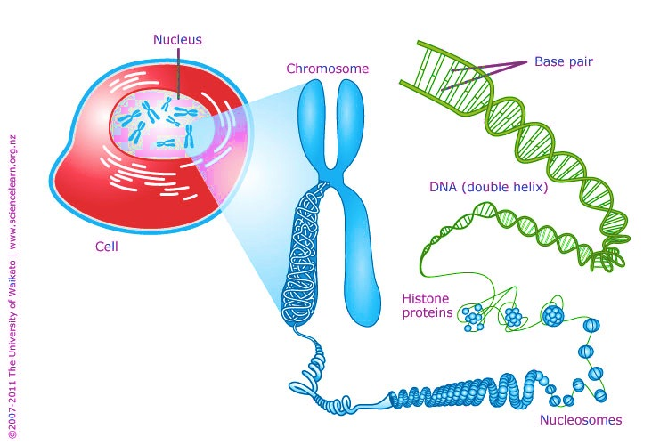
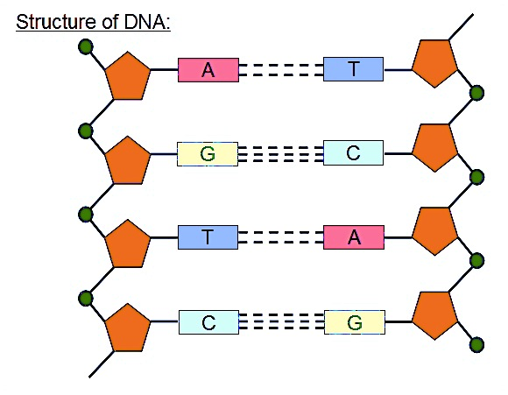
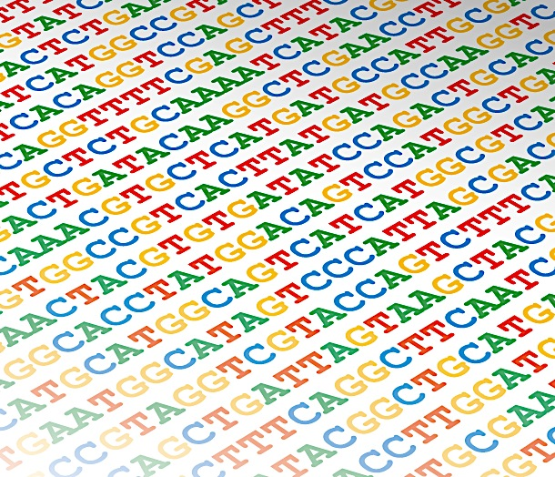
DNA
Notes:
1 meters long

Slide 9
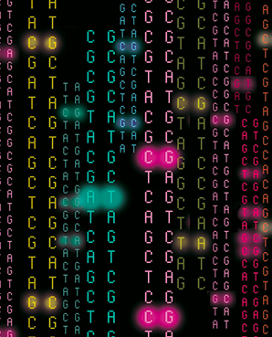
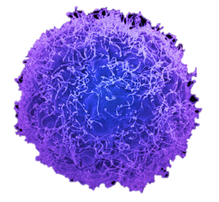
How does the DNA code “run” inside the cell?
?

Slide 10
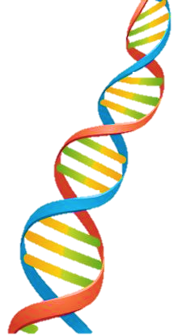
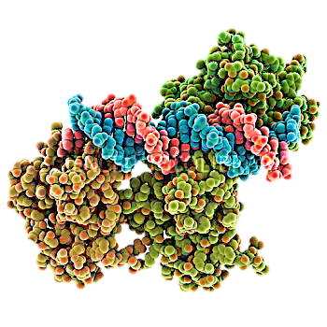
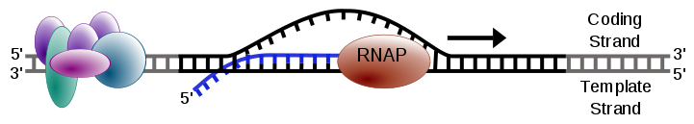
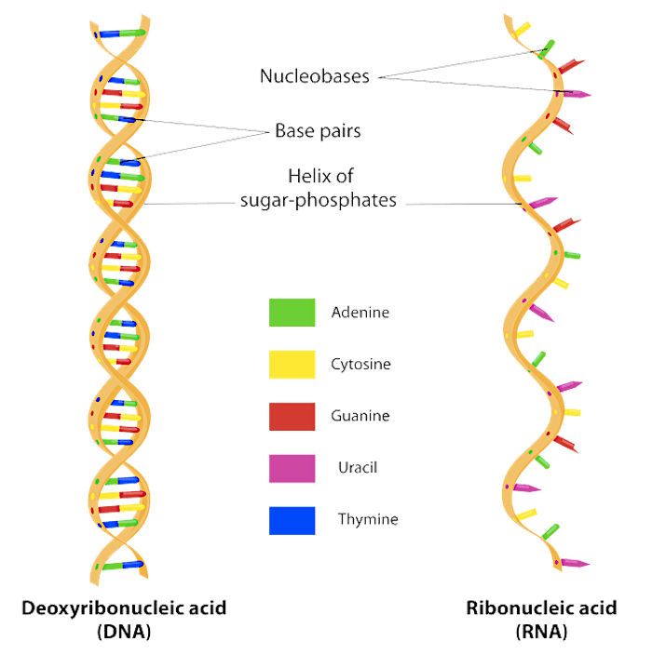
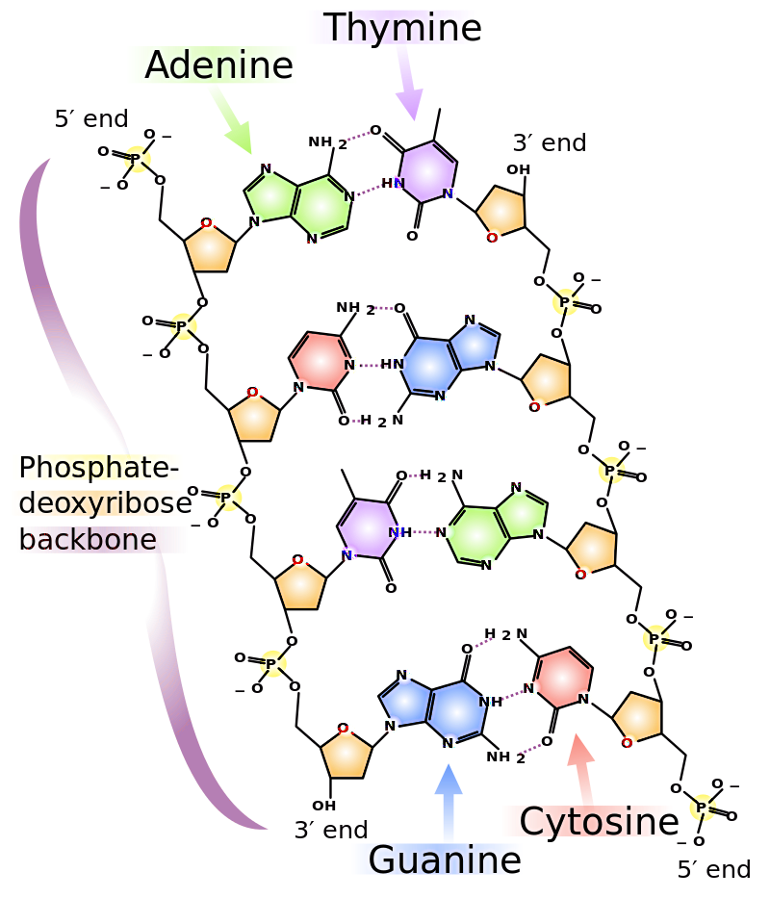

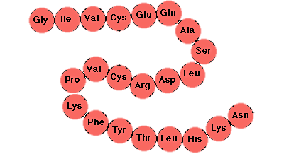
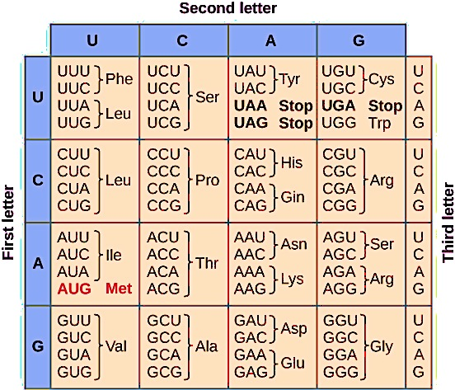
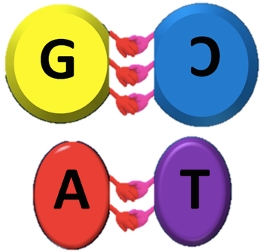
Central Dogma of Biology [/Life]
replication
transcription
translation
DNA
RNA
Protein
Alphabet: A,C,U,G
Alphabet: A,C,T,G
Alphabet: 20 amino-acids

Slide 11

[VIDEO: CDB]

Slide 12
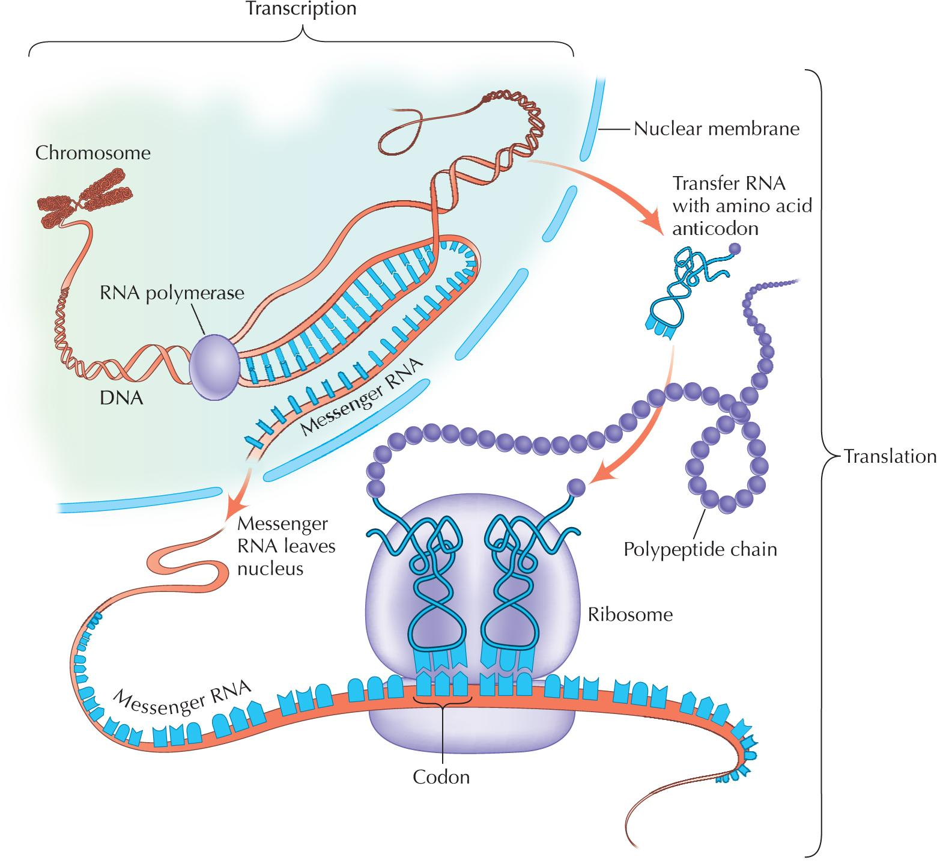
Central Dogma of Biology [/Life]

Slide 13
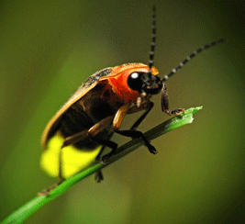
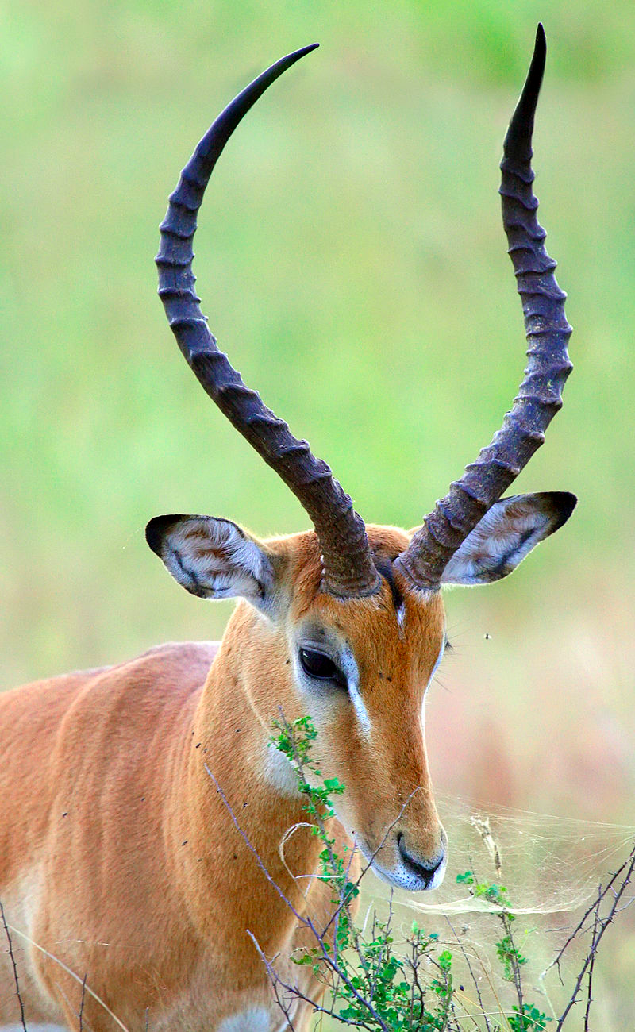

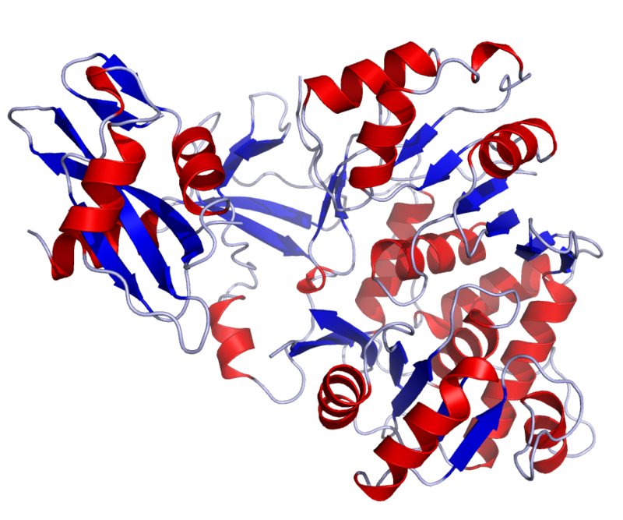
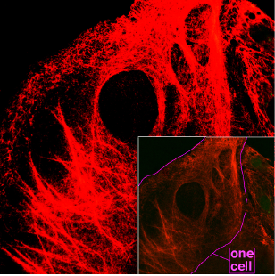
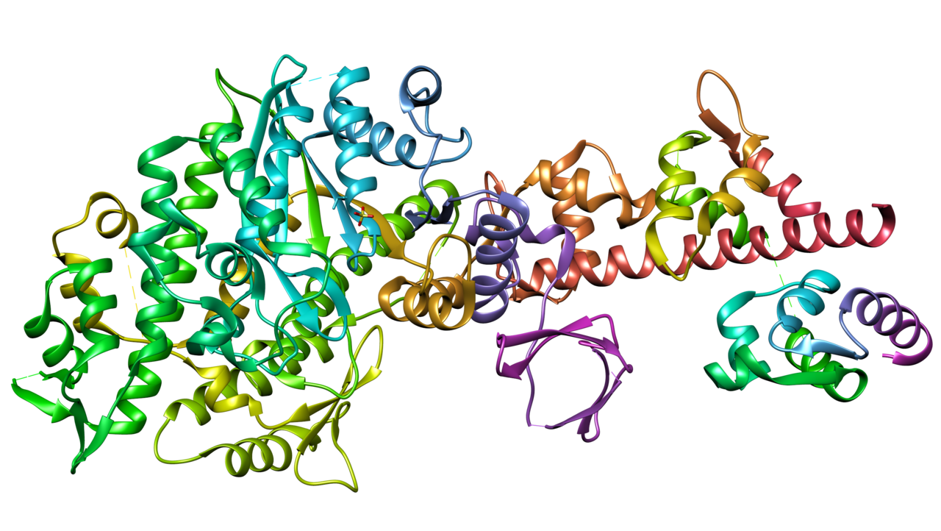
Proteins
Luciferase: enzyme that makes the abdomen of fireflies glow
Keratin: fibrous structural protein that is a key component of hair and nails
Myosin: motor protein involved in muscle contraction

Slide 14
Let’s try it out: Exercise 1

Slide 15
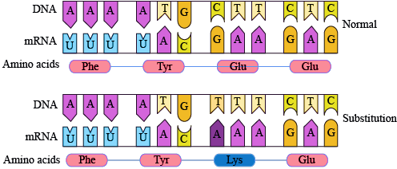
What happens if there is a “bug” in the code?

Slide 16

[VIDEO: Mutations]

Slide 17
Let’s try it out: Exercise 2

Slide 18
Cancer is a disease of the genome.

Slide 19
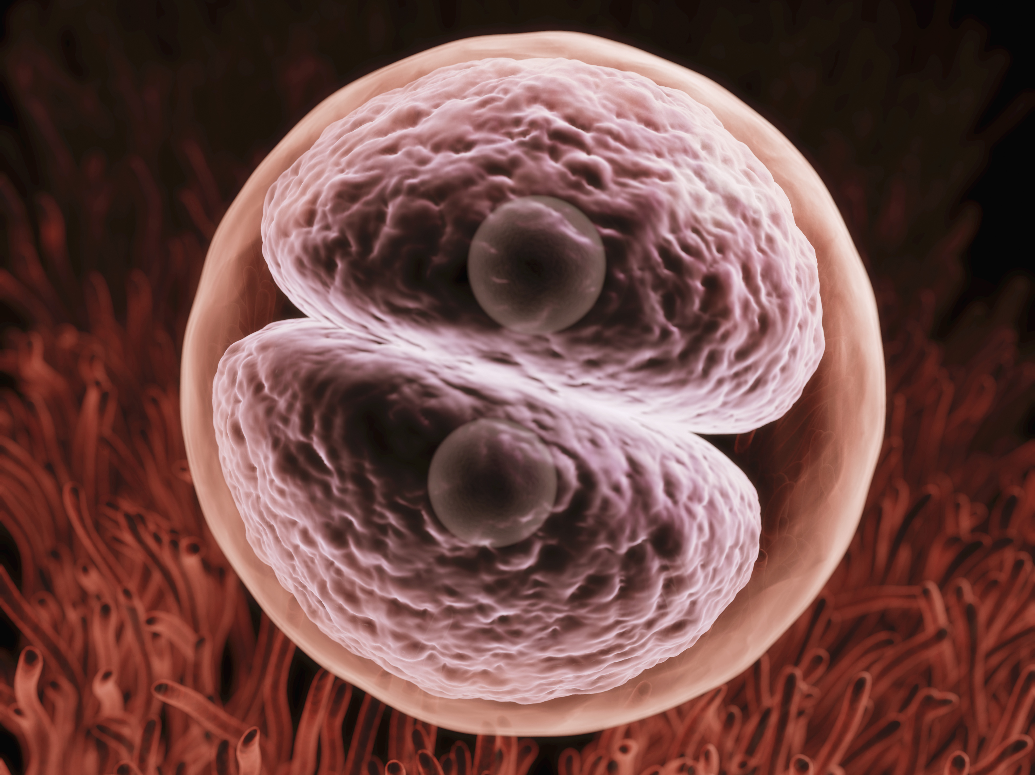

Slide 20
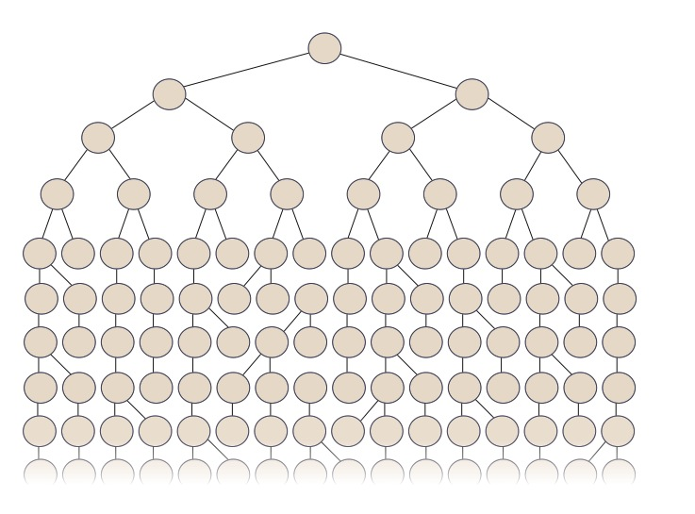




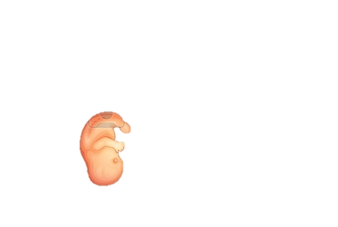
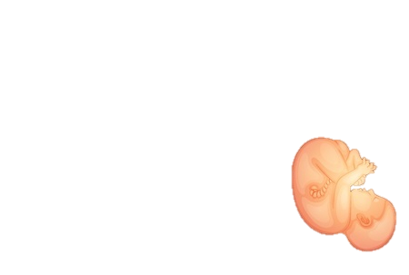
Source: Dorna Kashef-Haghighi

Slide 21
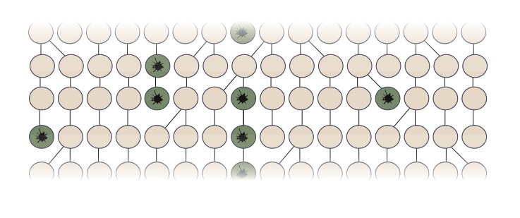

Slide 22
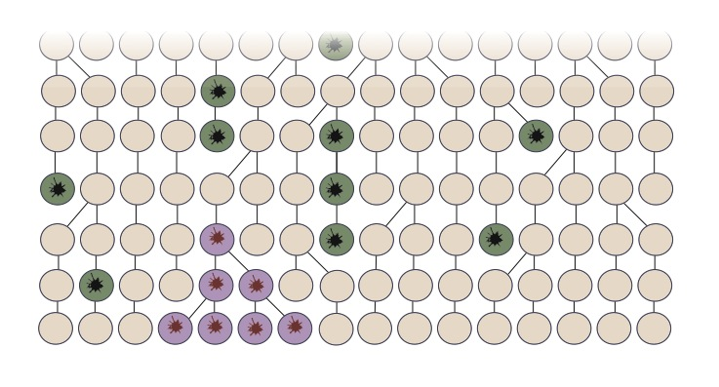

Slide 23
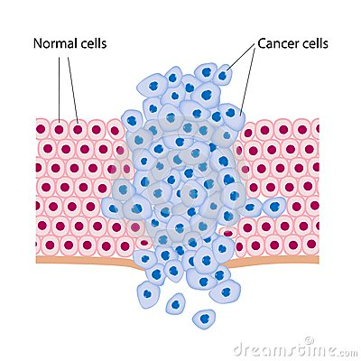

Slide 24
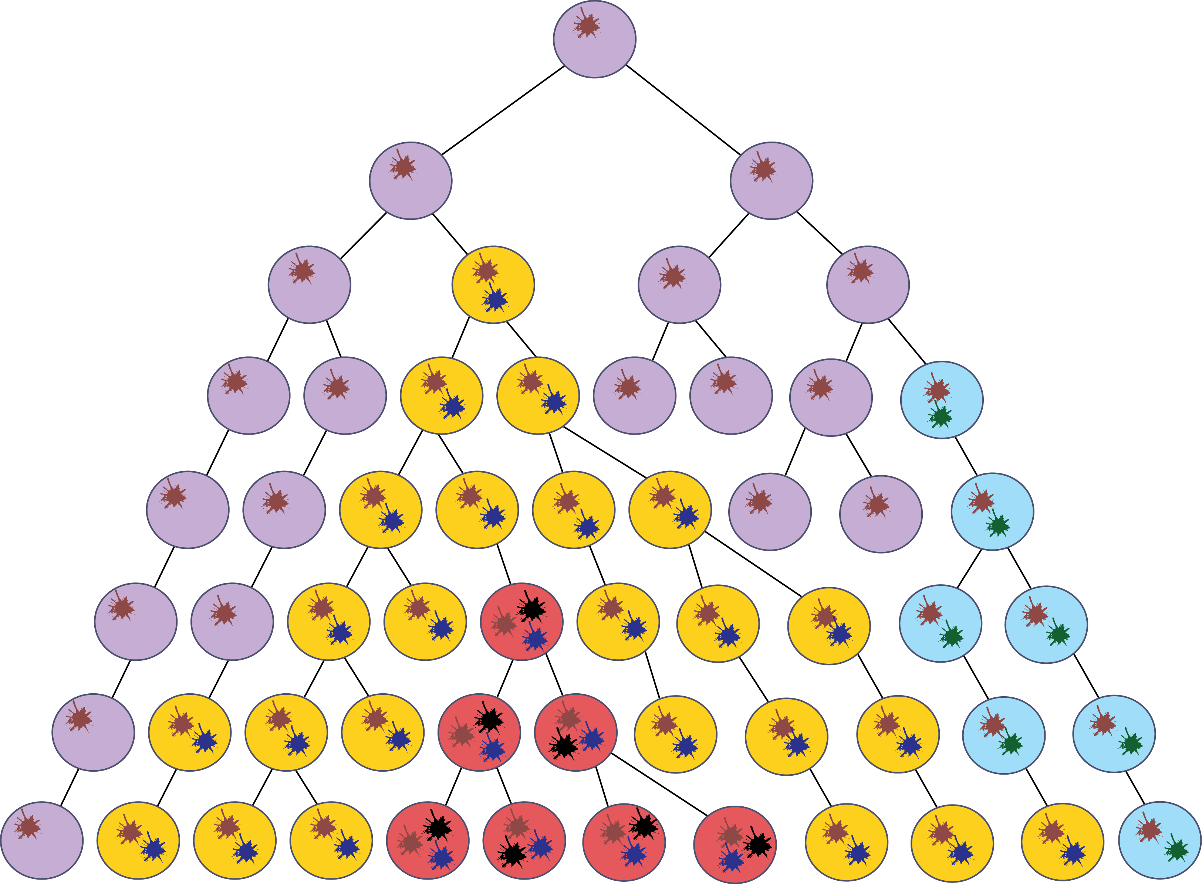
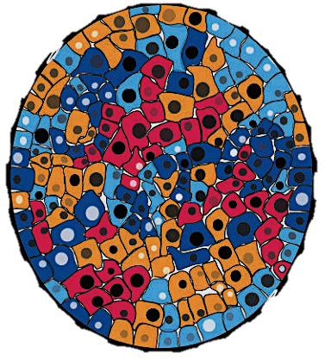
Tumors are heterogeneous colonies of “out-of-control” mutant cells

Slide 25
How can we detect cancer?

Slide 26
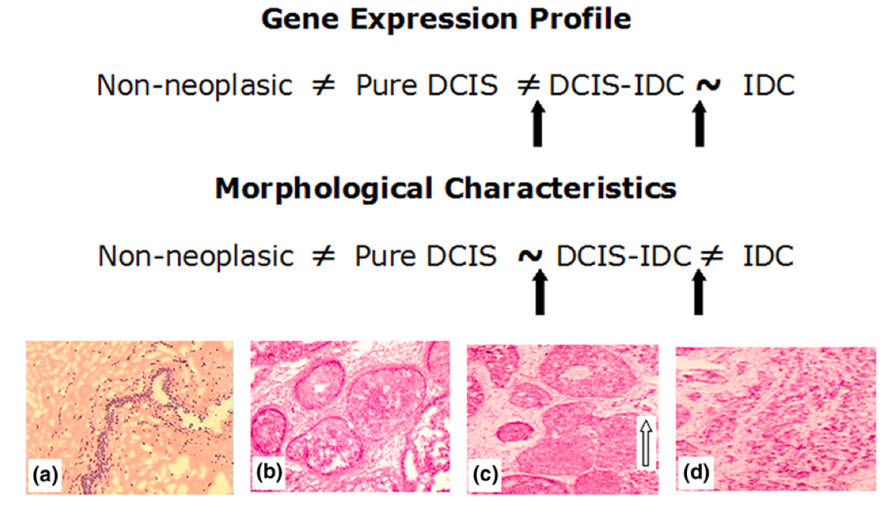
We can look at the cells under the microscope – tumor cells can have different morphology

Slide 27
We can look at the cells under the microscope – tumor cells can have different morphology

Slide 28
How can we tell what the cell is doing?

Slide 29
Measure what proteins are being made!

Slide 30
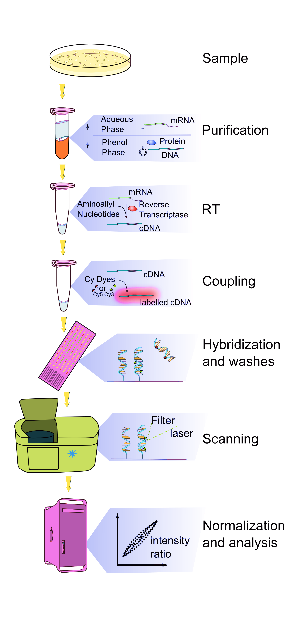
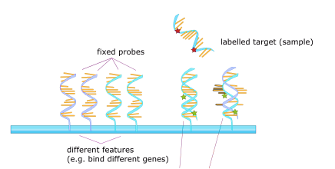
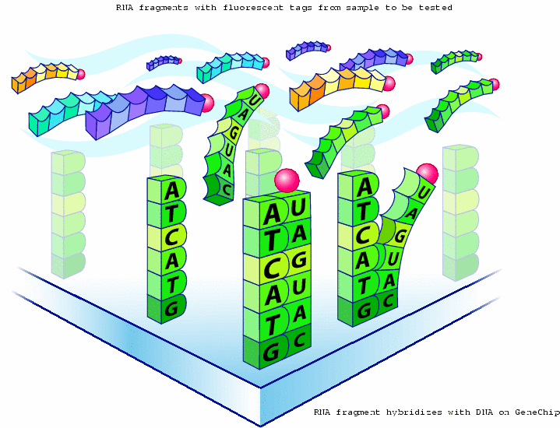
Gene Expression Profiling with Microarrays

Slide 31

Microarrays

Slide 32
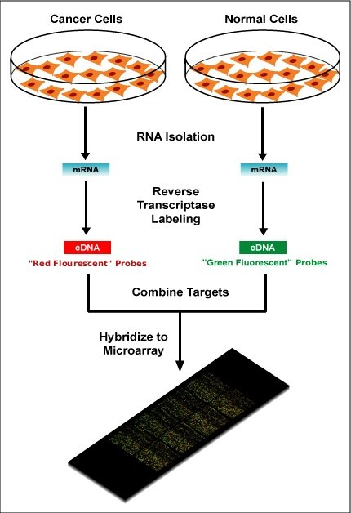
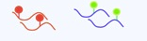
Normal versus Tumor

Slide 33
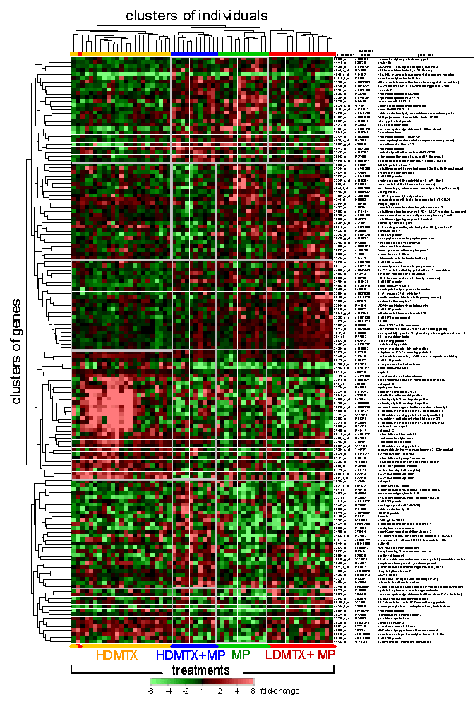
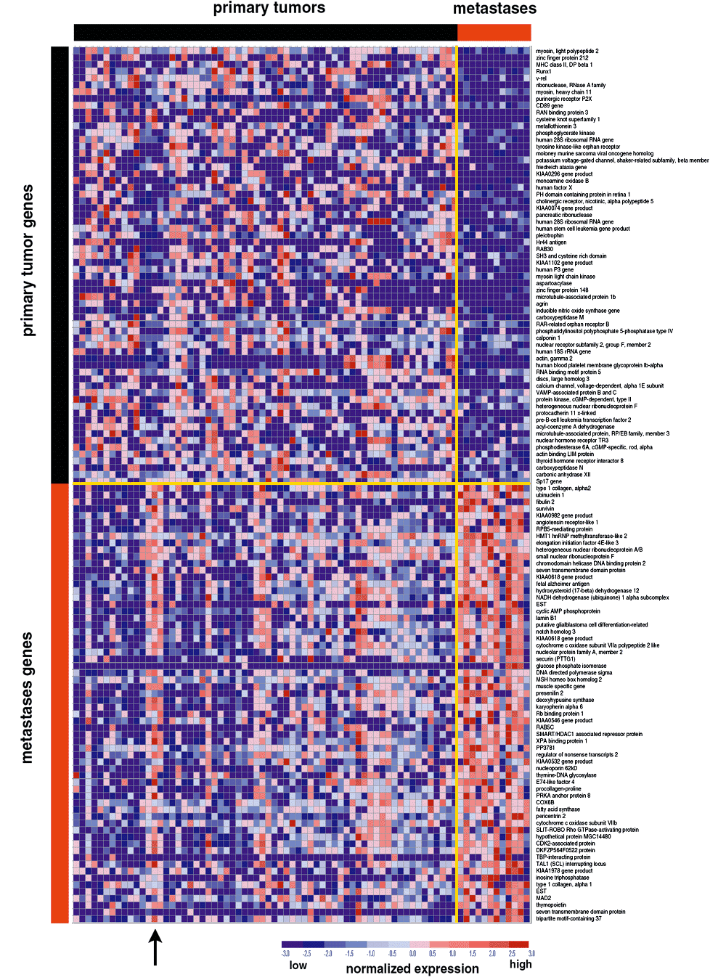
Multiple tumor samples

Slide 34
If we had several examples of normal and tumor cell data, what would we do to determine whether an unknown sample is tumor or normal?

